Slide 1
IDS Synthetic Data Generation Mini-hackathons
-- Tabular Data Generation --
Chang Sun
23/01/2025

Slide 2
Synthetic data
Synthetic data is information that's artificially generated rather than produced by real-world events. Typically created using algorithms, synthetic data can be deployed to validate mathematical models and to train machine learning models.
Tabular (relational data)
Time-series
Image
Audio
Video
Text

Slide 3


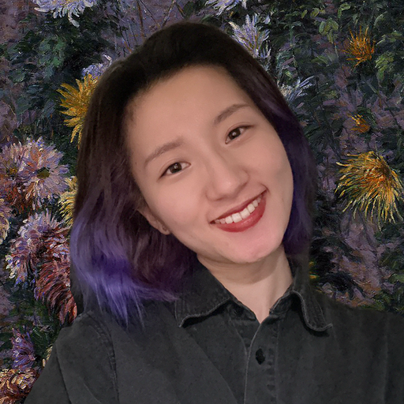
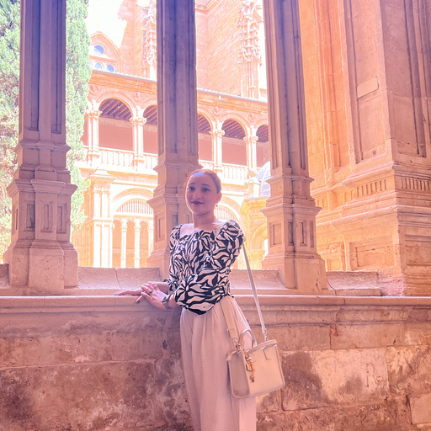





Synthetic data at IDS
Synthetic data is information that's artificially generated rather than produced by real-world events. Typically created using algorithms, synthetic data can be deployed to validate mathematical models and to train machine learning models.
Tabular (relational data)
Time-series
Image
Audio
Video
Text
… …

Slide 4
IDS Synthetic Data Generation Mini-hackathons
Host | Date | Topics
Chang Sun | 23-Jan-2025 | Tabular data generations - DP-CGANS
Mahmoud | 27-Feb-2025 | Diffusion Models for time-series data
Kaspar | 27-Mar-2025 | Diffusion Models for chest x-rays
Yaru, Komal | 24-April-2025 | Drug-RAG claim generation
Thales | 22-May-2025 | Text generation and evaluation
Adi | 26-June-2025 | Multi-modal generation
Summer break
Rishabh | 25-Sep-2025
 | 23-Oct-2025
 | 27-Nov-2025
2-h hands-on Hackathon
Once per month
To learn from each other’s work and do hands-on practice

Slide 5
For today, tabular data generation
Get to know different tabular data generation models
Hands-on practice using different models
Group assignments

Slide 6
Different generation models
Supervised learning
Domain knowledge based
Distribution based
Neural Networks (Deep learning)
Unsupervised learning

Slide 7

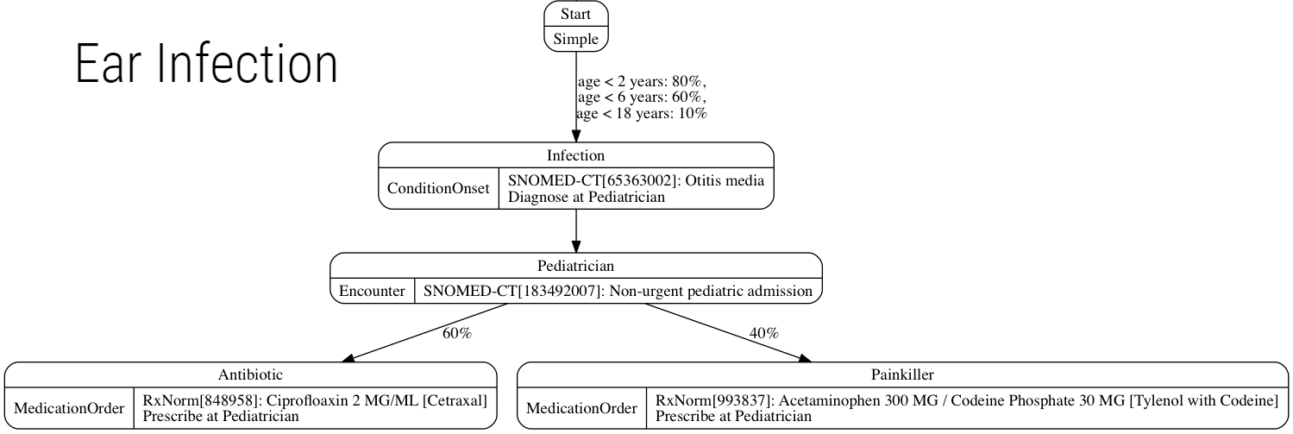
Domain knowledge based
Domain knowledge based
Distribution based
Neural Networks (Deep learning)
publicly available health statistics
clinical practice guidelines
medical coding
terminology standards

Slide 8

Domain knowledge based
Domain knowledge based
Distribution based
Neural Networks (Deep learning)
Each synthetic patient contains a complete medical history, including medications, allergies, medical encounters, and social determinants of health.
This data can be used without concern for legal or privacy restrictions.
A variety of data standards, including HL7 FHIR®, C-CDA and CSV.
To try: https://github.com/synthetichealth/synthea/wiki/Basic-Setup-and-Running

Slide 9
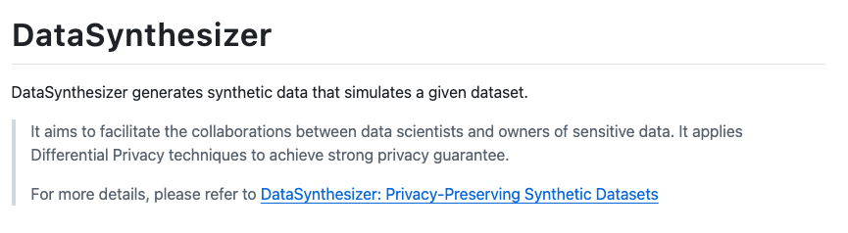
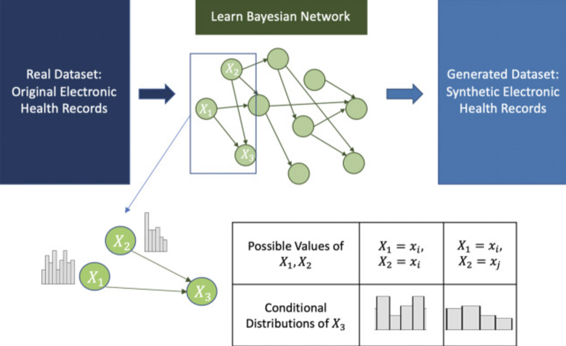
Distribution based
Independent Marginals: sampling from the empirical marginal distributions of each variable.
Domain knowledge based
Distribution based
Neural Networks (Deep learning)
Computationally efficient
Unable to capture statistical dependencies across variables
To try: https://github.com/DataResponsibly/DataSynthesizer

Slide 10
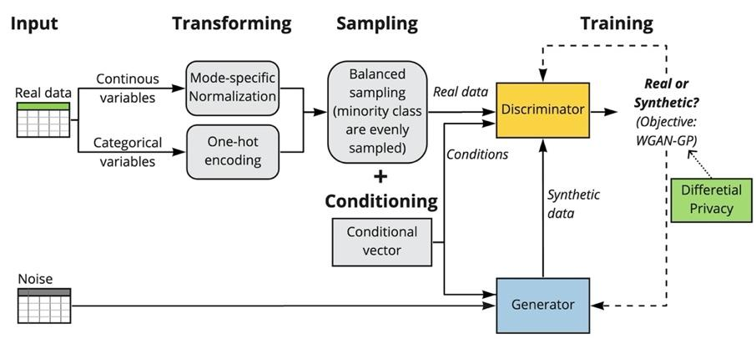
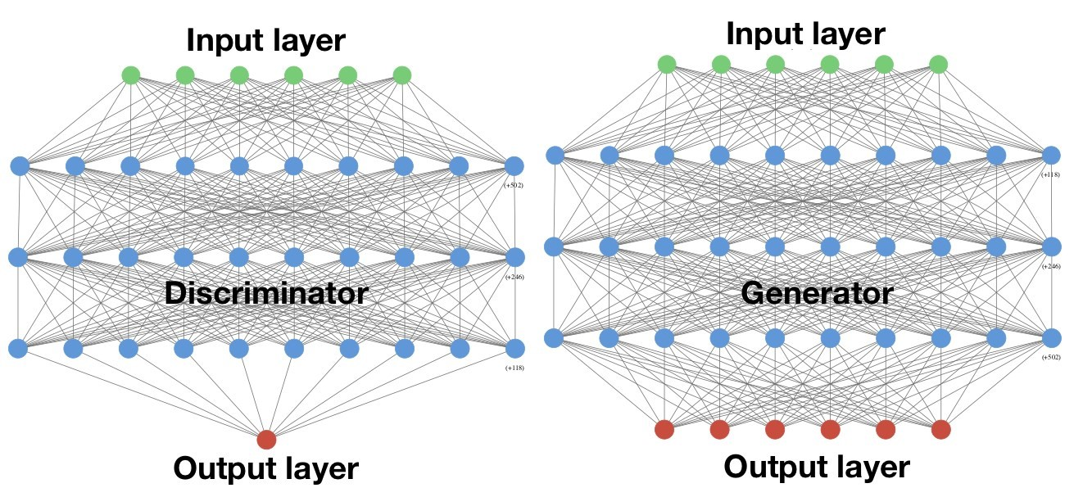
Neural Networks based
Generative Adversarial Network (GAN): trains and leverages two opposing neural network models (a generator and a discriminator) in a competitive manner.
Domain knowledge based
Distribution based
Neural Networks (Deep learning)

Slide 11
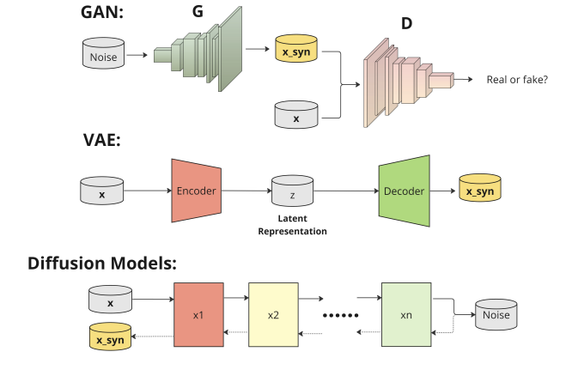
Neural Networks based
Generative Adversarial Network (GAN): trains and leverages two opposing neural network models (a generator and a discriminator) in a competitive manner.
Domain knowledge based
Distribution based
Neural Networks (Deep learning)
Other common deep learning models:
Variational Autoencoder (VAE)
Diffusion Models

Slide 12
Models for today:
DP-CGANS
CTGAN
TVAE
Gaussian Copula
CopulaCGAN
Framework:
Synthetic Data Vault
Synthcity

Slide 13
Models: DP-CGANS (as an example)

Slide 14
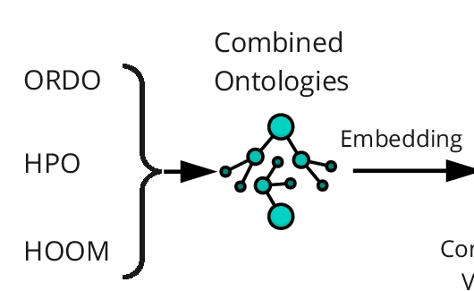
Additional: ONTO-CGAN

Slide 15
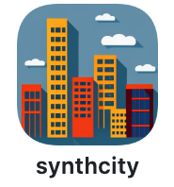
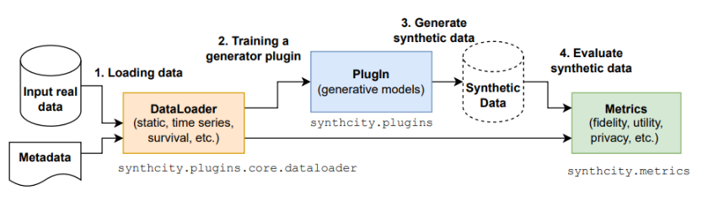
Framework: Synthcity (as an example)
To Try: https://github.com/vanderschaarlab/synthcity

Slide 16
Models for today:
DP-CGANS
CTGAN
TVAE
Gaussian Copula
CopulaCGAN
Framework:
Synthetic Data Vault
Synthcity

Slide 17
Try out with examples:

Slide 18
Simple assignment in groups (https://bit.ly/syndata0123)
Use case 1: Find the best (most suitable) model
Use case 2: The Role of Hyperparameters
Use case 3: Generative models on different datasets
Use case 4*: Generative models for your own project

